Slide 1






Halight Performance Intelligence Dashboard
Transforming Learning Data into Actionable Insights
Group 8: Aum, Sakshi, Souravdeep, Faiyaz, Priyanka
Transparency
Data Integrity
Scalability

Slide 2






The Challenge: Proactive Intelligence
The Problem
The Solution
Disconnected data silos make it difficult to identify at-risk learners and understand true content performance across the platform, leading to reactive instead of proactive management.
An end-to-end data pipeline feeding a Flask dashboard, powered by predictive machine learning and LLM-driven recommendations to centralize intelligence and drive learner success.
BUSINESS VALUE
RECOMMENDATION
CORE VALUES
Centralizing data silos reduces operational overhead and enables a 360-degree view of learner health, improving retention rates.
Break down organizational silos to foster a data-driven culture across all departments for unified decision-making.
Transparency & Data Integrity

Slide 3








Robust Infrastructure & Pipeline
Seamless integration orchestrated via AWS Athena with local Parquet caching to eliminate latency and optimize costs.
Cost Efficiency: Local Parquet caching reduces AWS Athena query costs by up to 70%.
Performance: Python pipeline (awswrangler/boto3) ensures sub-second dashboard response.
Scalability: Decoupled architecture allows for seamless ML model updates and scaling.
BUSINESS VALUE
RECOMMENDATION
CORE VALUES
Significant reduction in cloud infrastructure spend while providing real-time insights for faster decision-making.
Implement automated data validation at the ingestion layer to ensure downstream model reliability and accuracy.
Scalability & Efficiency

Slide 4













Refining Data for High-Fidelity Insights
Process
Methodology
Impact
Log1p & Spearman Correlation
Handled outliers and skewed distributions for robust modeling
Cleaning
li_attempts Deep-Dive
Captured active days, completion rates, and granular scores
Engineering
PCA Loadings
Statistically justified engagement metrics for unbiased analysis
Weighting
BUSINESS VALUE
RECOMMENDATION
CORE VALUES
Statistically justified metrics (PCA) ensure that interventions are based on true engagement, not noise, reducing false alarms.
Periodically re-calibrate engagement weights to adapt to changing platform features and evolving user behaviors.
Precision & Data Integrity

Slide 5









Proactive Churn Prediction (XGBoost)
Optimized XGBoost Classifier High-accuracy model deployed to identify at-risk learners before they drop out, enabling early intervention.
Leakage Elimination Removed 'days_since_last_login' to ensure realistic and robust model performance in real-world scenarios.
Explainable AI (SHAP) Integrated SHAP values to provide transparent, per-user churn risk drivers, building trust with non-technical managers.
BUSINESS VALUE
RECOMMENDATION
CORE VALUES
SHAP values translate complex ML outputs into human-readable drivers, building executive trust and enabling targeted action.
Deploy automated alerts for high-risk segments to trigger immediate human-led intervention and personalized support.
Transparency & Accountability

Slide 6







Understanding Users & Growth
RFM Segmentation
Growth Forecasting
Robust clustering mapping users into Power, Casual, and Inactive tiers for targeted engagement.
Utilizing Prophet to project engagement and user growth for the next 30 days with high confidence.
BUSINESS VALUE
RECOMMENDATION
CORE VALUES
RFM segmentation optimizes marketing ROI by focusing retention spend on high-LTV "Power" users and identifying growth opportunities.
Develop tailored content tracks for "Casual" users to migrate them into the "Power" tier through personalized learning paths.
Customer-Centricity & Growth

Slide 7




Interactive Intelligence
Flask Dashboard Demo
Real-time monitoring of Monthly Growth Metrics and Churn Risk Overviews for immediate operational awareness.
Marketing Action Board: Integrated LLM-based recommendations providing data-backed strategies for non-technical stakeholders.
BUSINESS VALUE
Real-time Flask dashboards empower non-technical stakeholders to make data-backed decisions instantly, reducing time-to-action.
RECOMMENDATION
Integrate LLM-driven marketing recommendations directly into existing communication workflows (e.g., Slack/Email).

Slide 8












Translating Models into Value
Retention Tracking
Resource Allocation
Actionable Marketing
Cohort analysis identifies drop-off points for targeted re-engagement, optimizing marketing spend.
Prioritize UI and content fixes based on SHAP-identified churn drivers to maximize impact.
LLM integration provides instant, readable marketing strategies for rapid execution.
BUSINESS VALUE
RECOMMENDATION
CORE VALUES
Cohort analysis quantifies the impact of product updates on retention, enabling a 20% optimization in marketing spend.
Use SHAP-identified churn drivers to prioritize the product engineering roadmap for maximum user retention.
ROI-Driven & Strategic Alignment

Slide 9







Looking Ahead
Personalization
Scale
Collaborative filtering engine for hyper-personalized learning.
Global multi-region deployment for low-latency access.
Real-Time
A/B Testing
Transition to AWS Kinesis streaming for instant data processing.
Direct dashboard integration for rapid feature validation.
BUSINESS VALUE
RECOMMENDATION
CORE VALUES
Transitioning to real-time streaming and personalization future-proofs the platform for global scale and hyper-engagement.
Prioritize the collaborative filtering engine to drive organic user engagement and platform stickiness.
Scalability & Continuous Improvement

Slide 10
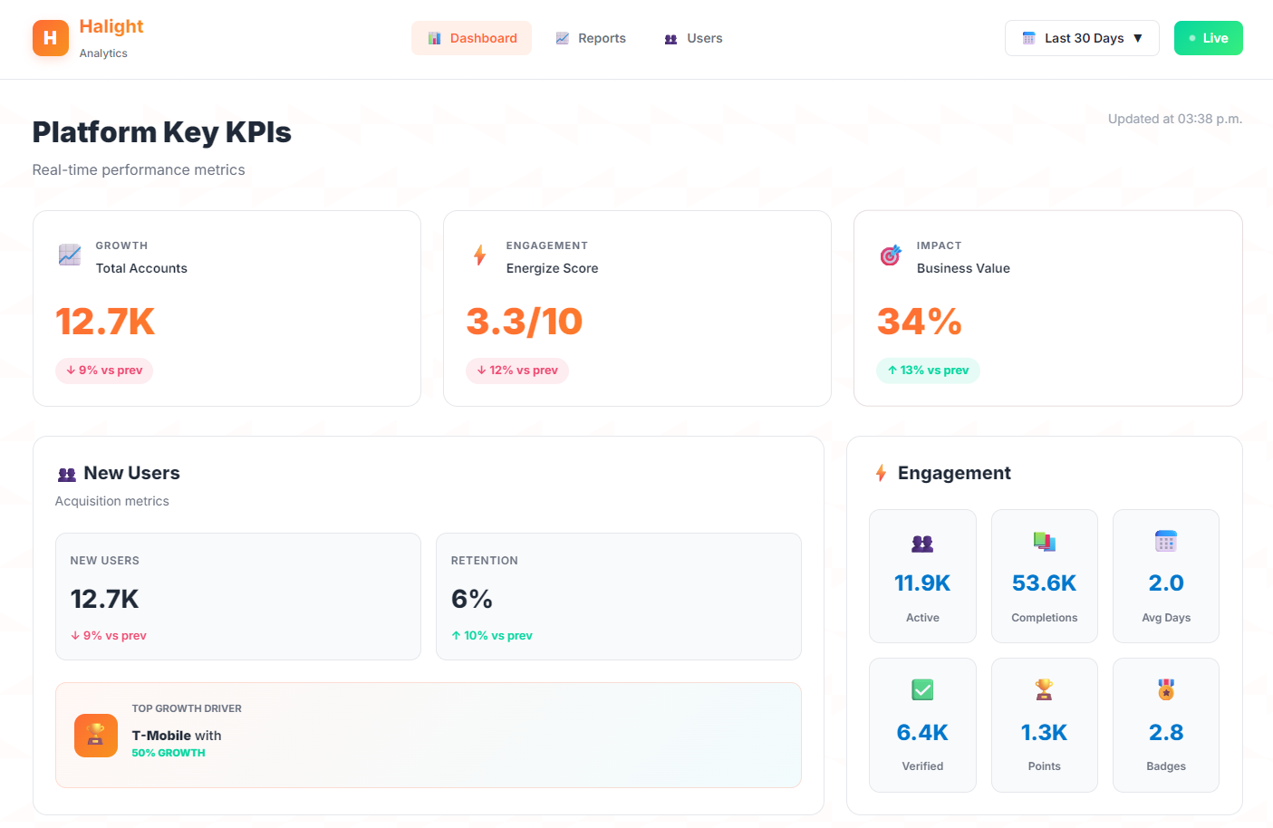
Dashboard Preview

Slide 11





Thank You
Driving strategic growth through performance intelligence.
Group 8 Project Repository
Transparency
Data Integrity
Scalability
ROI-Driven

